Slide 1

DriverPass System Analysis
[Anh Tran]
Notes:
[No speaker notes required for this slide.]

Slide 2

System Requirements
Functional requirement:
Making appointments
Access to learning materials
Take practice test
Nonfunctional requirement:
Security
Download speed of learning materials
Able to access from any platform and any devices
Notes:
[In your speaker notes, include an explanation of the different requirements you determined for DriverPass’s system. What are the functional requirements you selected to describe? What are the nonfunctional requirements you selected to describe? Be sure to explain how these requirements meet DriverPass’s needs.]

Slide 3
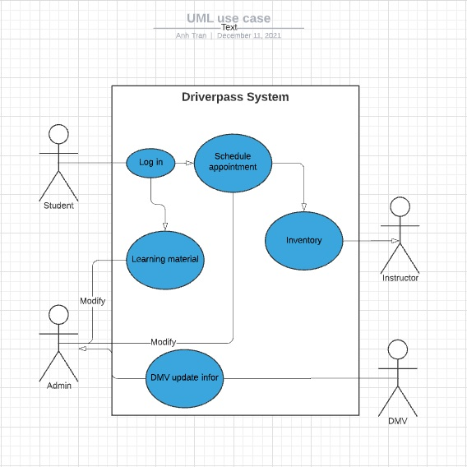
Use Case Diagram
Notes:
[Explain your diagram. Who are the different actors in the system? What are the different use cases? How did you account for DriverPass’s needs in your design? In your explanation, keep your audience in mind. Avoid the use of terms like “actors” and “use cases” in your explanation.]

Slide 4
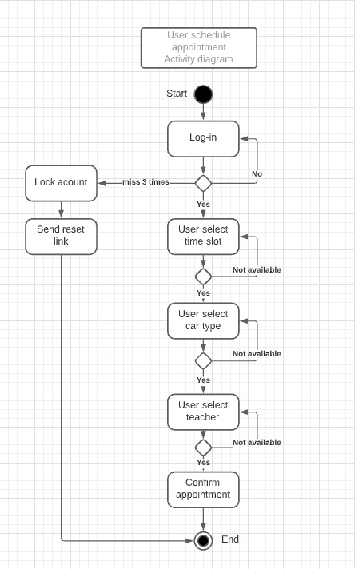
Activity Diagram
Notes:
[Explain your diagram. Which use case are you breaking down? What are the steps for this use case? How did you account for DriverPass’s needs in your design? In your explanation, keep your audience in mind. Avoid the use of technical terms such as “nodes,” “control flows,” and so on.]

Slide 5
Security
This system only allow users with verified information to gain access to the learning materials and schedule appointments
Validating user input
Any exploits will notify admin
Notes:
[How did you consider security in your design? In your explanation, keep your audience in mind by avoiding the use of technical terms.]

Slide 6
System Limitations
If cloud service provider has problems, the system might not be able to access while the server is in maintenance
Constant update with new regulations
Notes:
[What are the limitations of your design? In your explanation, keep your audience in mind by avoiding the use of technical terms.]

